Slide 1
MYLEGION:
REGISTER AN ACCOUNT
Register a MYLEGION account to view and manage membership for The American Legion and Sons of the American Legion.
2026

Slide 2
ABOUT MYLEGION
MYLEGION is an American Legion website for Legion and Sons of the American Legion members.
One account provides all LGN and SAL membership details and administrative tools.
All accounts are individual. Post and Squadron membership is accessed through the individual MyLegion account. Do not share your UN and PW.
Email must be on your membership record on file at National HQs. Registering with an email not listed as your primary email will not provide access to membership details or leadership resources.
Notes:
MyLegion is an American Legion website for Legion and Sons of the American Legion members.
<1> Membership details for both The American Legion and Sons of the American Legion are included in one account, along with any administrative tools and resources provided to adjutants and commanders.
<2>All accounts are individual. Post and Squadron membership is accessed through your individual MyLegion account. Do not share your username and password with others.
<3>The Email used during registration must be on your membership record prior to registration. Registering with an email not listed as your primary email will not provide access to membership details or leadership resources.

Slide 3
BEFORE YOU REGISTER
Do you have an email address on your membership record?
Email browser should be open to receive a onetime password (OTP) during registration.
Be prepared to create a password that meets the requirements below:
One Uppercase Letter
One Lowercase Letter
One Number
One Symbol (!@#$%^&*)
Eight character minimum
Notes:
Before registering an account, you may want to verify your email address is correct on your membership record with your post or department leadership. All MyLegion accounts are to be registered with the primary email address. Registering without an email on your membership record will create an account with no member details. Before registering an account, you may want to verify your email address is correct on your membership record with your post or department leadership. All MyLegion accounts are to be registered with the primary email address. Registering without an email on your membership record will create an account with no member details.
<1> Open your email browser to receive an email that will be sent. During registration, a one-time password is sent to complete registration with email verification.
<2>Be prepared to create a password. Password requirements include: <3> 1 Uppercase letter, 1 Lowercase letter, 1 Number, 1 symbol, and have an eight (8) character minimum.

Slide 4
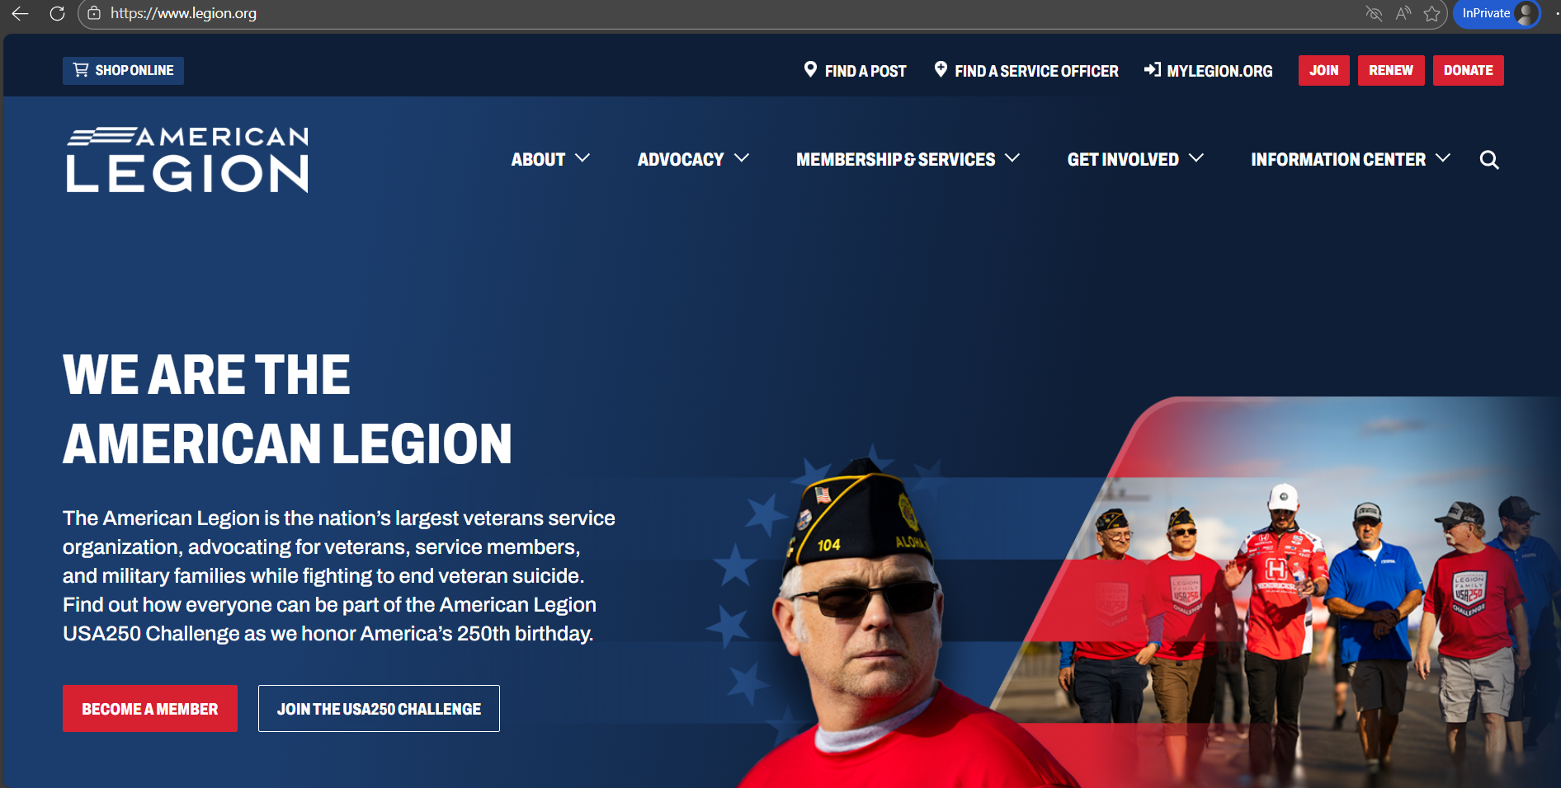

LEGION.ORG
Notes:
The American Legion National website is legion.org. Located at the top of the page is a link for MyLegion.

Slide 5
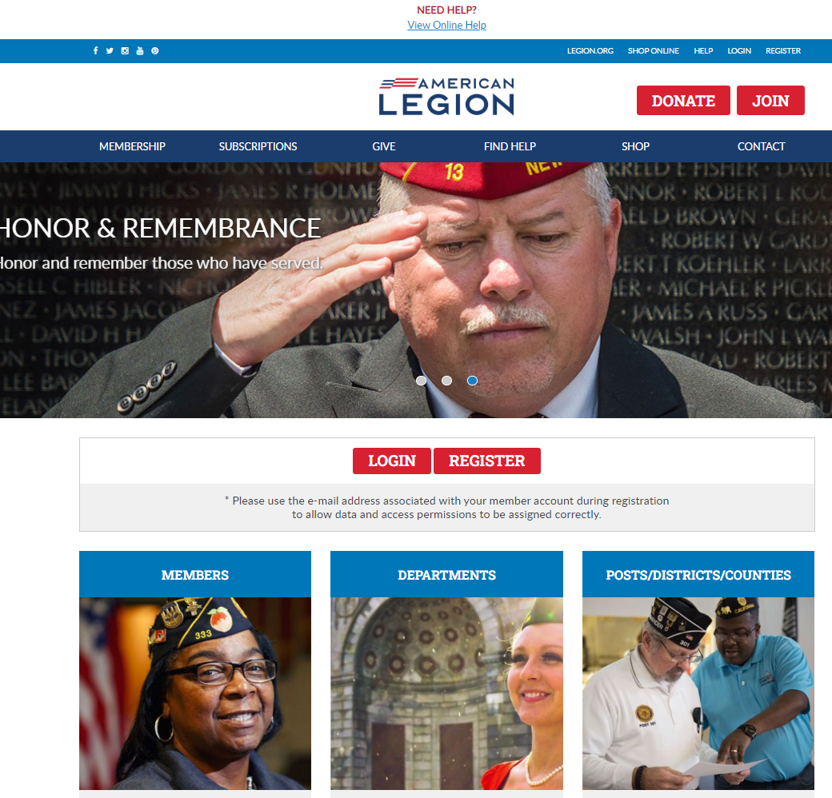
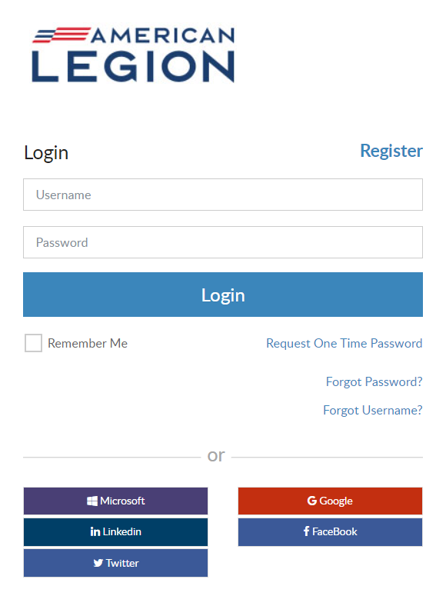

Notes:
In the upper right, click Register. <1> Notice, there may be additional places to access the same tool. Log in and register is also located in the middle of the page. Begin registration by entering your primary email address.

Slide 6
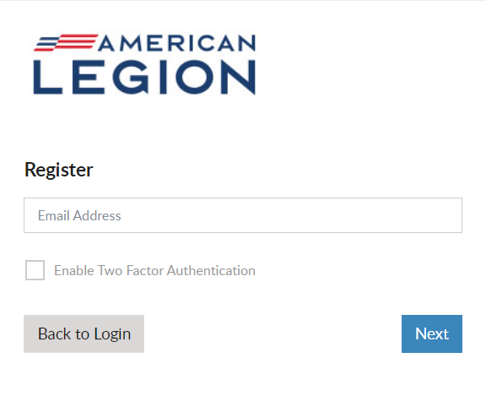
REGISTRATION
Email address is required to register.
Open Email browser to retrieve verification code.
No Email? Go back and contact local or department leadership prior to registering an account.
Do not use an email shared by another individual or group of individuals.
Notes:
Enter your email address and click Next. An email is required. Remember to have your email open during registration to receive a verification code after this step.
<1> If you do not have an email address do not proceed. Exit the site and contact your post adjutant, department headquarters or national customer service to add an email to your record prior to registering an account.
<2> Do not use an email shared by another individual or group of members.

Slide 7
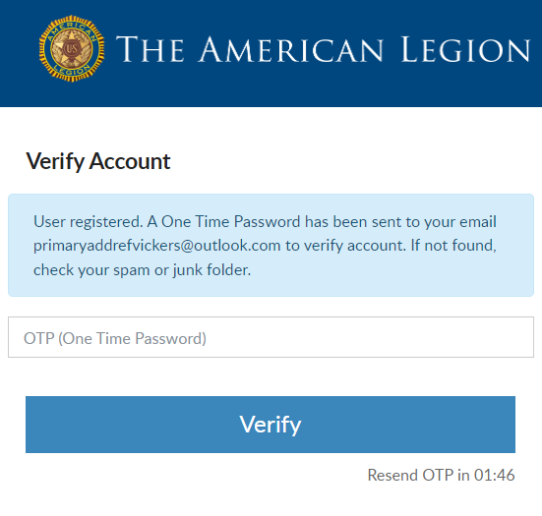
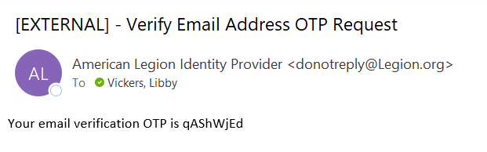

VERIFY ACCOUNT
Do not close this window. Go to your email to retrieve the OTP.
2 minutes to complete.
Notes:
A Verify Account window opens to verify you have access to the email address.
Do not close this window. Return to your email to retrieve a one-time password. <1> This message comes from The American Legion Identify Provider. Check your Spam or Junk folders if you do not see the message within 10-15 seconds. The email will be sent immediately. <2> There is a 2-minute time allotment to enter the one-time password and verify. It the time expires you will see a message to request another OTP. This step ensures that you have access to the email associated with this account.

Slide 8
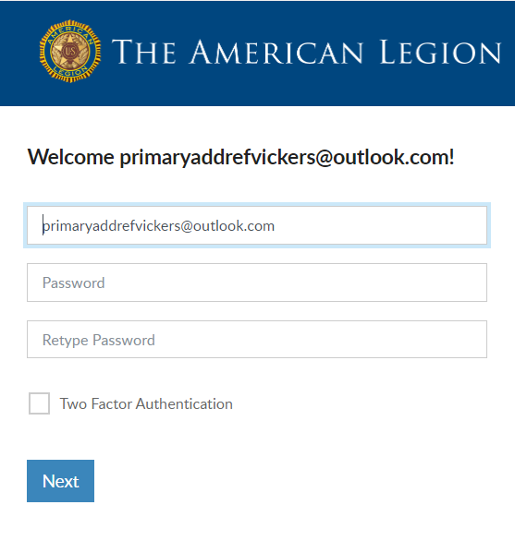
USERNAME AND PASSWORD
Username defaults to email address.
Create Password.
Two Factor Authentication.
Password Requirements:
Uppercase Letter
Lowercase Letter
Number
Symbol (!@#$%^&*)
8-character Minimum
Notes:
Members will receive a welcome window to complete the final step, create a password.
The username defaults to the email address entered. It is recommended to leave the email address as your username. However, you can update the username in this window by updating it in the Username field. When creating a username, try to use something unique.
<1> Create a password using the following criteria: 1 upper and lowercase letter, 1 number, 1 symbol or special character and a minimum of 8 characters in total.
<2> Two-factor authentication is an extra layer of security to ensure that you're the only person who can access your account, even if someone knows your password. This extra security measure requires you to verify your identity using a randomized code we’ll email you each time you attempt to log in. Applying this feature is available when you first create your account. It can be added or removed later through your account.
Click “Next” to proceed.

Slide 9
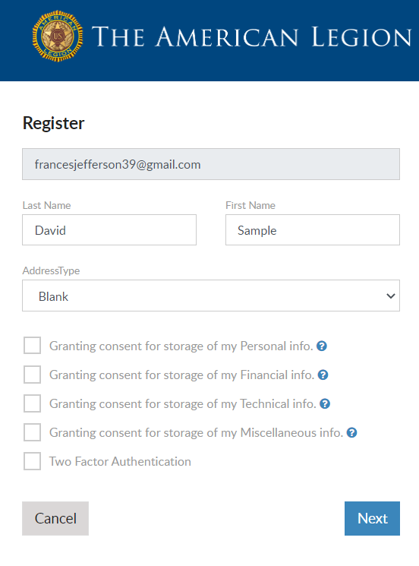


CAUTION
LGN and SAL members do not proceed if you receive this window.
Email entered does not match what is on member record.
Contact local or department leadership to verify email on file.
primaryaddrefvickers@outlook.com
Notes:
Members of The American Legion and Sons of the American Legion should not proceed if this window appears asking to grant consent. Continuing will not connect to your membership details.
<1>The email address entered must match what is on file at national headquarters. Members should double-check how the email address was entered. Was it entered correctly? If not, cancel and try again. <2> If it is entered correctly, click Cancel and contact your local or department leadership or national customer service to update your primary email address.

Slide 10
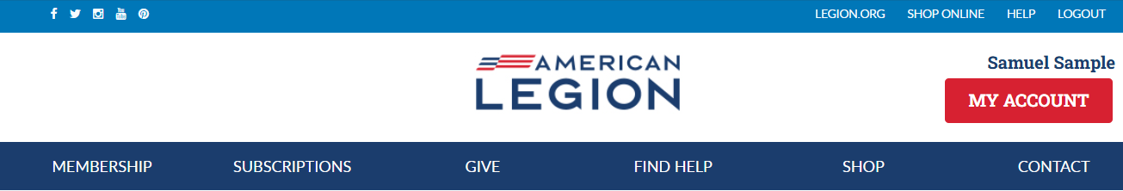
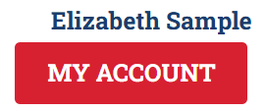
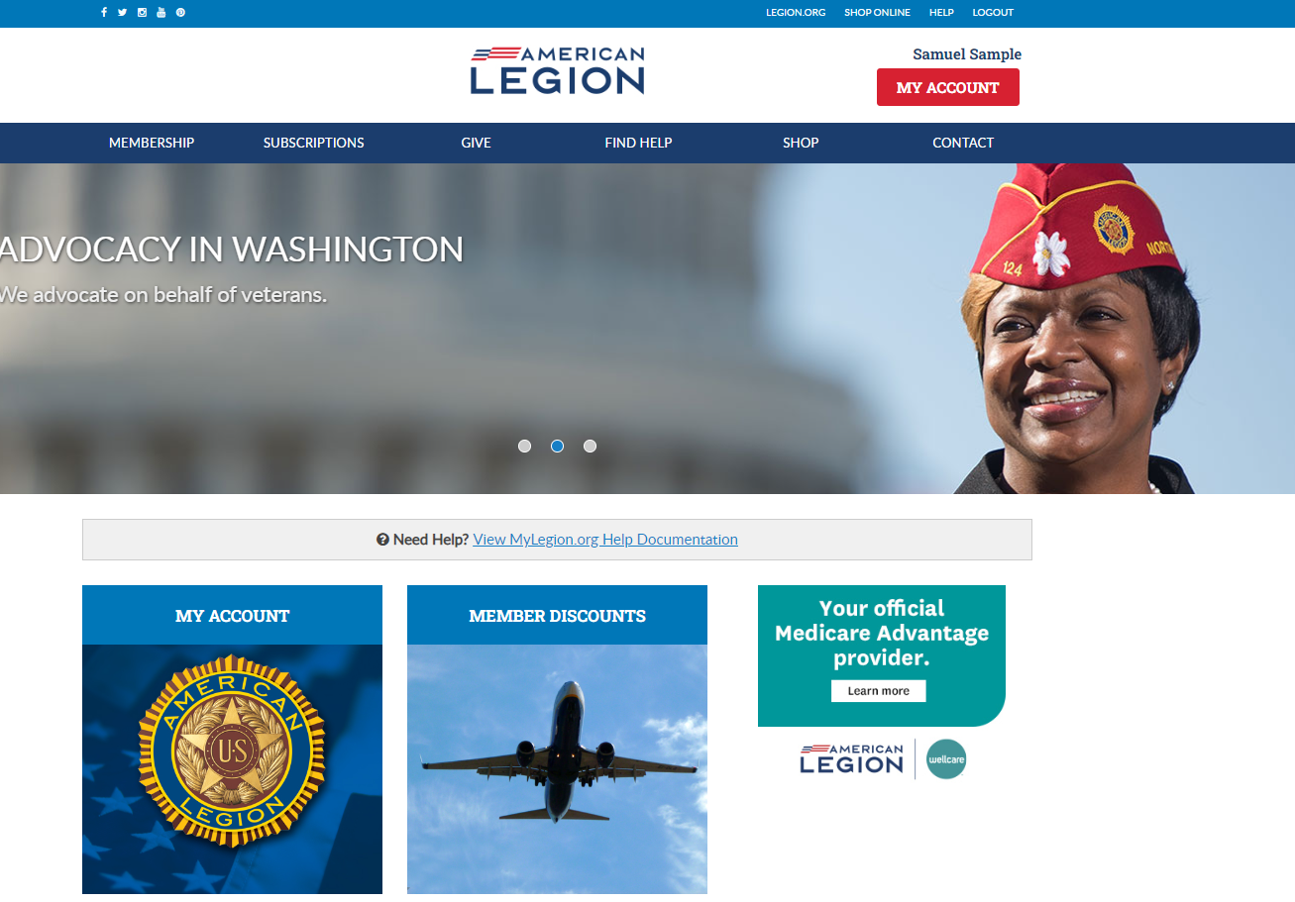
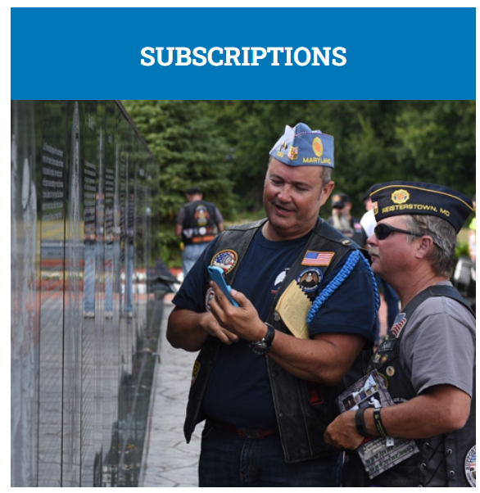
Notes:
When registration is complete, MyLegion opens displaying your name located above the MY ACCOUNT button.

Slide 11
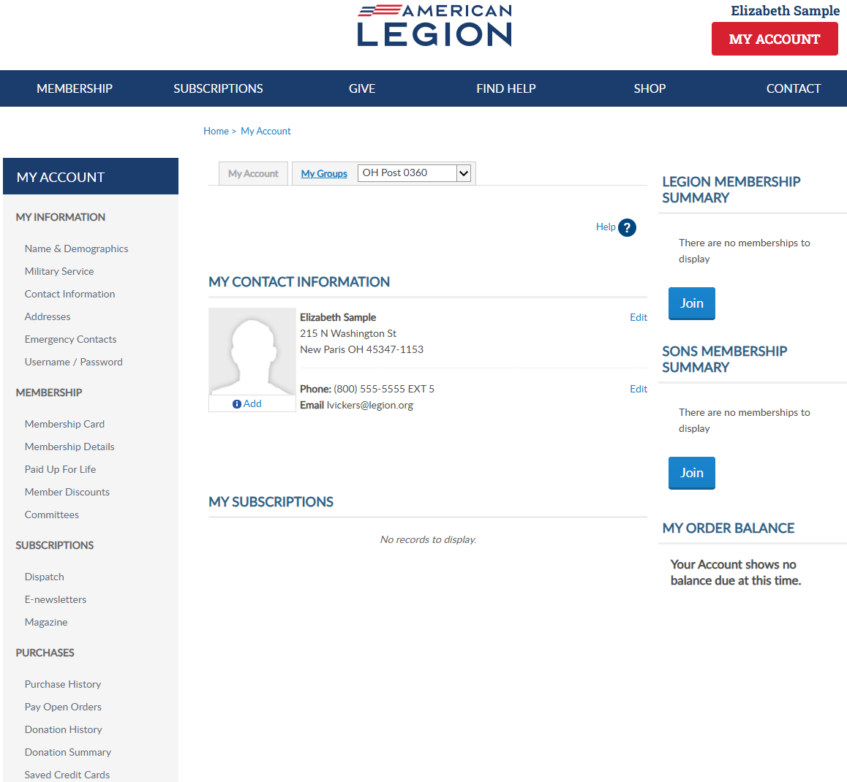
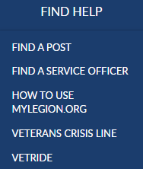
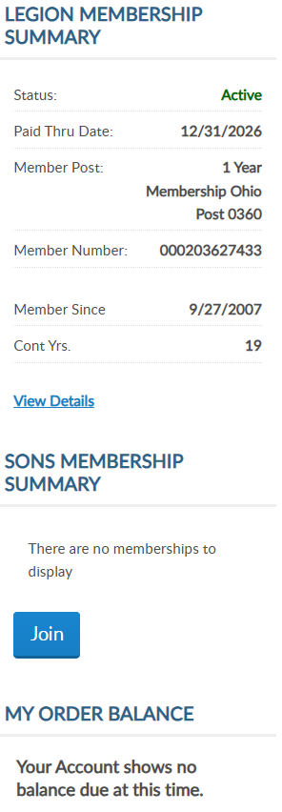
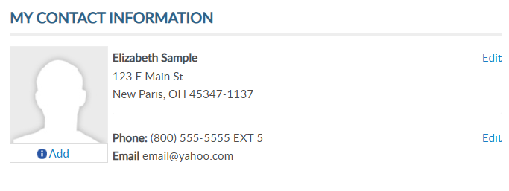
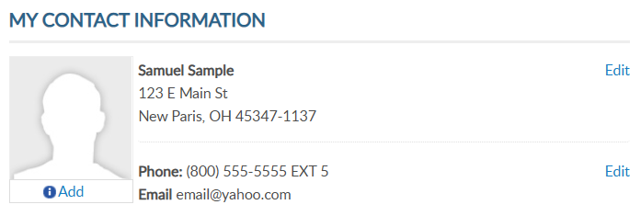
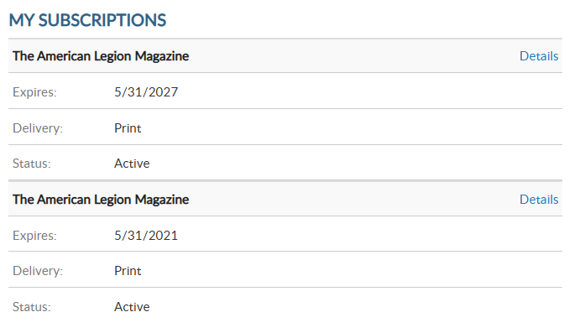
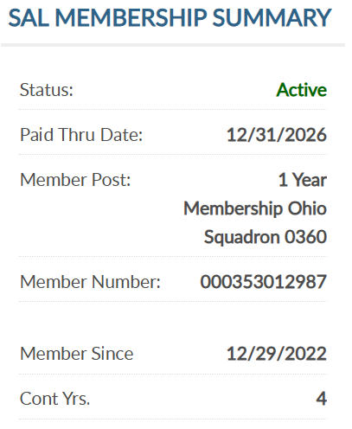

MY ACCOUNT & HELP RESOURCES
000123456789
000123456789
Notes:
Membership summaries will let you know your membership status, post, ID number, join date and continuous years. For members of the Sons of the American Legion, you will see the same details. Note: Membership ID numbers are the same for both. If they are not, please contact your state headquarters.
Learn more about MyLegion using “Find Help” and go to How to use MyLegion.org.

Slide 12
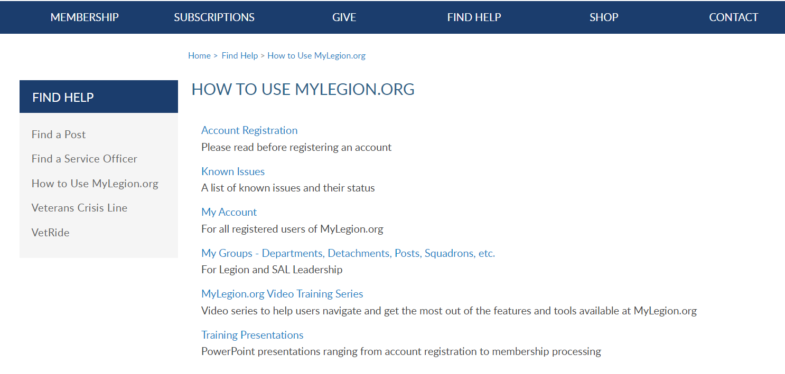
Online Help
Notes:
Step by step instructions, videos and training presentations will assist with how to manage your member account and groups in MyLegion.

Slide 13
MYLEGION SUPPORT
MyLegion@legion.org
833.253.9995
Monday – Friday
8:00am – 4:30pm
(Eastern)
The American Legion National HQs
5745 Lee Road
Indianapolis, IN 46216
Contact your MyLegion support team to assist with any questions or tools on your MyLegion account.
Notes:
Contact your myLegion support team to assist with questions and tools for MyLegion. Email mylegion@legion.org or call 833-253-9995 Monday through Friday.

